Slide 1
Lecture 6: System Roles & Stakeholders;
System Acceptance
Neelima Satyam
IIIT, Hyderabad

Slide 2
The success of man-made systems in achieving success within an organization is determined by HOW WELL the system is specified, designed, developed, integrated, verified, validated, operated, and supported.

Slide 3
End User An individual or organization that benefits directly from the outcome or results of a system, product, or service.
Stakeholder An individual or organization that has a vested interest (e.g., friendly, competitive, or adversarial) in the outcome produced by a system in performing its assigned mission.
System User An individual or organization that employs a system, product, or service or their by-products for purposes of accomplishing a mission-oriented objective or task. For example, a city transportation system employs bus drivers and buses to transport people from one location to another. The bus drivers and passengers are categorized as users.

Slide 4
Roles of Stakeholders
  Somebody who benefits from it
  May not benefit but thinks of it as a friendly
  The system is in competition to the current one or s/he is part of
  Adversarial – in conflict with

Slide 5
ORGANIZATIONAL SYSTEM ROLES
Organizational systems perform roles that reflect their chartered missions and objectives within their business domains. examples of system roles and missions.
SYSTEM ROLE CONTEXT
Every man-made system performs mission-oriented operations and tasks intended to accomplish specific performance-based objectives and outcomes to support their customers, the Users and stakeholders. The conduct of these missions requires two types of operational roles: mission system and support system.

Slide 6
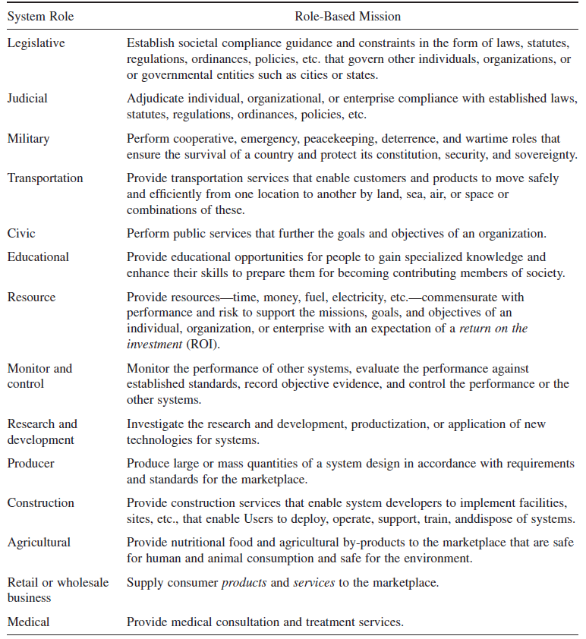

Slide 7
Closed Source or Proprietary Software
Roles are -
  Draw up the Specifications
  Programming/Coding team
  Integration
  Testing
  Marketing
  Support
  Project Management

Slide 8
Air transport system
\An airline’s MISSION SYSTEM consists of the aircraft and crew with an objective to safely and comfortably transport passengers and cargo between cities. The aircraft’s SUPPORT SYSTEM consists of baggage handlers, mechanics, facilities, ground support equipment (GSE), and others that function in their own MISSION SYSTEM roles to prepare the aircraft for a safe flight, replenish expendables and consumables, and load/unload cargo and passenger luggage.

Slide 9
Organizational System Roles Relate to SE?
Physical systems, such as hardware, software, and courseware, exist because higher level human organizations, as Users, employ and leverage physical system capabilities to achieve organizational goals, missions, and objectives within budgetary cost and schedule constraints.
As an SE, you must fully comprehend, understand, and appreciate HOW the User intends to deploy and employ a system in a prescribed operating environment to achieve the organization’s goals, objectives, and missions.
In the airline business, you provide or contract for reservation and ticketing services, check-in and baggage handling, aircraft, gate facilities, special services, or security. All these entities require physical systems—as well as hardware and software—to perform the organization’s role.
The organization may:
1. Develop a system, product, or service.
2. Procure the system, product, or service from other vendors.
3. “Outsource” (e.g., contract, lease) for the systems or services.

Slide 10
Roles to Entities
Entities have
  goals, objectives, missions, or performance requirements that contribute to achieving the organization’s role

Slide 11
A tool is an instrument used to perform an action or operation. This can be any hand held implement, such as a paint brush, a screw driver or a hammer, etc. In addition, a power driven instrument or piece of machinery used within a manufacturing setting can be regarded as a tool. Within computer technology, a tool can be a particular software program or a part thereof. The spellchecker in Microsoft Word, for instance, can be viewed as a tool.
A process is a series of actions or functions performed in order to achieve a result. In manufacture, a process involves all the steps required to turn raw materials into the finished product. A business or administration process refers to the way in which a business or administration is run, again following a set of certain steps. In computer science, a running software program or part of it, in fact any computing operation is known as a process.
A product is an article or substance which has been created or perfected for sale through the use of tools and the application of a process. The creation of a product may also be the result of a natural process.
The differences between these three terms are obvious: Tools are tangible objects used to perform actions; processes are sets of pre-determined actions put in the required order to achieve an end result, and products are the tangible results of the use of tools and the application of specific processes

Slide 12
When an organization, such as an airline, initiates operations, large numbers of humans must be an integral part of the planning, implementation, and operation activities.
Each stakeholder has a vested interest or stake in the outcomes and successes of the organization’s role and its embedded systems.
Human-made systems, from conception through disposal, require human support, both directly and indirectly. Humans with vested interests in a system, product, or service expect to contribute to the conceptualization, funding, procurement, design, development, integration, operation, support, and retirement of every system.
Depending on the size and complexity of the system, including risks and importance to the User, stakeholder roles may be performed by an individual, an organization, or some higher level enterprise such as a corporation, government, or country

Slide 13
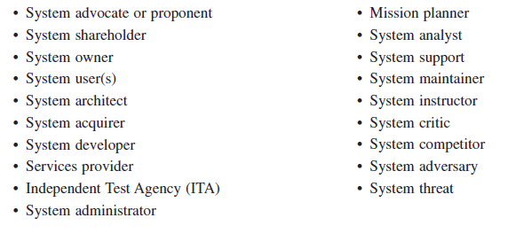
System Stakeholder Roles

Slide 14
Multiplicity of Stakeholder’s roles
The context of stakeholder roles centers on a SYSTEM OF INTEREST (SOI). Recognize that the individual, organizations, or enterprises that perform these roles may be stakeholders in other systems. In fact, stakeholder roles may vary from system to system.
Example: The System Advocate for your system may serve as a System Owner for numerous systems. Users may employ several other systems to achieve their own mission goals and objectives. The System Developer may be the developer of numerous systems and system maintainer of other systems.

Slide 15
System Acceptability
The degree of success of any human-made system and its mission(s) ultimately depends on:
Whether the marketplace is ready for introduction of the system—an operational need driven “window of opportunity.”
The User’s perception of the system’s operational utility, suitability, and availability.
The system’s ability to accomplish the User’s mission—system effectiveness.
The return on investment (ROI) for the resources expended to operate and maintain the system— cost effectiveness.
Different groups in the chain view this differently

Slide 16
Choice and Use of the Sytem
The four degree of success factors listed are seldom optimum simultaneously. Though appearing to be equal, psychologically, the subjective measures—namely, perception of operational utility, suitability, and availability (factor 2)—often obscure the objective measures of system success—system and cost effectiveness (factors 3 and 4).
Subjective look, feel, and perception within the peer community or by the funding source factors often doubtful User acceptance that a system may only be partially successful.
Conversely, the User for the same subjective reasons may reject an objectively successful system.

Slide 17
Measures of a System
Measures of Effectiveness (MOE)
“A qualitative or quantitative measure of the performance of a model or simulation or a characteristic that indicates the degree to which it performs the task or meets an operational objective or requirement under specified conditions.”
Measures of Performance (MOP)
“Measures of lowest level of performance representing subsets of measures of effectiveness (MOEs). Examples are speed, payload, range, time on station, frequency, or other distinctly quantifiable performance features.”
Measures of Suitability (MOS)
Objective performance measures derived from subjective user criteria for assessing a system’s operational suitability to the organizational and mission applications.
Operational Effectiveness
  “An operational Test & Evaluation (OT&E) metric

Slide 18
Measures of a System
Operational Suitability
“The degree to which a system can be placed satisfactorily in field use with consideration being given to availability, compatibility, transportability, interoperability, reliability, . . . usage rates, maintainability, safety, human factors, manpower supportability, logistic supportability, natural environmental effects and impacts, documentation, and training requirements.”
System Effectiveness
“A quantitative measure of the extent to which a system can be expected to satisfy customer needs and requirements.
f(suitability, dependability, reliability, availability, maintainability and capability)

Slide 19
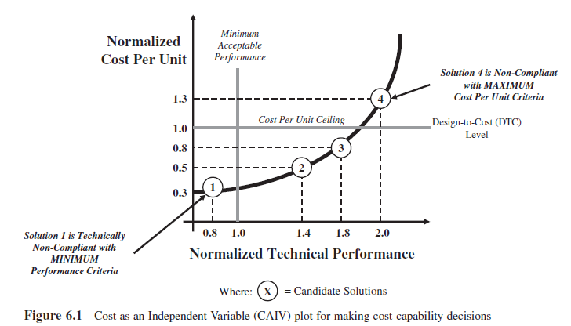
Cost Effectiveness
Are cost effectiveness and system effectiveness analyses easy to perform? No. In fact both are often very difficult to quantify and measure. Implementation of these details varies by organization and program.

Slide 20
Challenges in Developing Systems
Acceptance to the user
Timing is RIGHT?
System feasibility and ROI
Does the proposed system have OPERATIONALLY UTILITY to the User relative to their organizational missions and objectives?
Is the proposed system OPERATIONALLY SUITABLE for all stakeholders relative to its intended application?
Is the proposed system OPERATIONALLY AVAILABLE when tasked to perform missions?
Is the system OPERATIONALLY EFFECTIVE, in terms of cost and technical performance, for its intended mission applications and objectives?

Slide 21
SYSTEM INTRODUCTION, FEASIBILITY,
AND AFFORDABILITY
Is the timing right to introduce a new system to the market/User, particularly in the commercial environment?
2. Is it economically feasible to develop a new system with the technologies currently available within budgetary constraints?
3. If development is economically feasible, will the User be able to afford the operating and maintenance costs over the planned service life of the system?

Slide 22
SYSTEM INTRODUCTION
You can innovate and develop the best widget or electronic mouse trap. However, if the marketplace is not mentally or skillfully ready for the device or can afford it, your efforts and investments may be futile
They may WANT and NEED a system yet lack sufficient funding. In other cases their funding may be placed “on hold” by decision authorities due to a lack of consensus regarding the maturity in system definition or understanding the system’s requirements.
Most organizations develop a series of decision-making “gates” that qualify the maturity of a business opportunity and incrementally increase the level of commitment, such as funding.

Slide 23
SYSTEM FEASIBILITY
System feasibility ultimately focuses on key questions:
1. WHAT does the User WANT/ NEED?
2. WHAT can the User AFFORD?
3. WHAT is the User WILLING to PAY?

Slide 24
System Verification and Validation
When the actual system is ready for field-testing, actual performance data are collected to:
1. Verify accomplishment of the requirements.
2. Validate models that the system successfully performs according to the User’s intended use.

Slide 25
Engineering of the system
  Conversion of users vision to an operable system
System integrity
  Confidence in the performance of the system
Reproducibility of the system

Slide 26
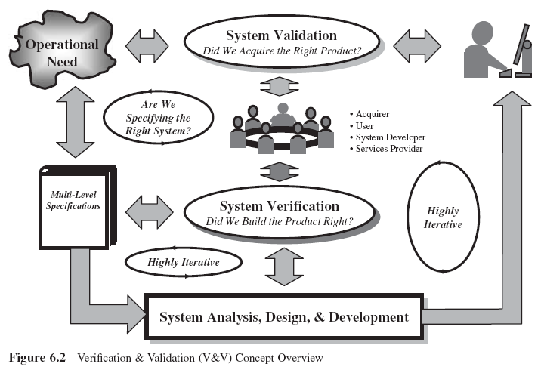

Slide 27
Guiding Principles
Principle 1 System acceptability is determined user satisfaction; user satisfaction is determined by five User criteria:
1. Provide value—meaning operational utility.
2. Fit within the user’s system and mission applications—meaning operational suitability.
3. Be available to conduct missions—meaning operational availability.
4. Accomplish performance objectives—meaning operational effectiveness.
5. Be affordable—meaning cost effectiveness.
Principle 2 Despite the most technically innovative and elegant SE design solutions, Users’ perceptions of a system, product, or service constitute reality.

Slide 28
A tool is an instrument used to perform an action or operation.
A process is a series of actions or functions performed in order to achieve a result.
A product is an article or substance which has been created or perfected for sale through the use of tools and the application of a process. The creation of a product may also be the result of a natural process.
The differences between these three terms are obvious: Tools are tangible objects used to perform actions; processes are sets of pre-determined actions put in the required order to achieve an end result, and products are the tangible results of the use of tools and the application of specific processes

